Slide 1

Temperature Converter & Grade Calculator
Presented By
Md Al-Amin Khan 1804043
Ashik Billah Fahim 1804036
Jawad Al Shahrier 1804045
Suzab Ud Doula 1804065
Supervised By
Animesh Chandra Roy
Assistant Professor
Dept. of CSE(CUET)
Md. Mynul Hasan
Lecturer
Dept. of CSE(CUET)

Slide 2
01
Introduction
02
Application
03
Motivation
04
Flow Chart
CONTENTS
05
Function Description
06
Project Output
07
Conclusion

Slide 3
Application: A temperature converter helps in the conversion of the measurement units which reduces the inconveniences of daliy life as different country or device prefers different measuring units. Temperature converter can be used in thermodynamics.
Project Name:
A temperature converter for Celsius, Fahrenheit and Kelvin scale.
Introduction:
A converter can convert units from one scale to another. The most popular scales for measuring temperature are Celsius, Fahrenheit and Kelvin.
The equation for converting temperature in Celsius, Fahrenheit and Kelvin scale is:
C/5=(F-32)/9=K-273/5

Slide 4
Motivation for this project: With the help of temperature converter,we can easily convert temperature in just one click in a very time effective way without using any equation or calculation.

Slide 5
Flow chart:
Creating the UI for temperature converter
Programming the clear and cancel button for the converter
Programming the convert button for the converter
Finally presenting the full project

Slide 6
Function Description: We used Java swing to creat the converter. For the UI components we used swing containers and swing control. For IDE we used NetBeans. The functions we used are listed below:
Javax.swing.jFrame:
Jframe is class type of container. It works like the main window where the swing containers and controls are added.
Javax.swing.JPanel:
Jpanel is a generic lightweight container. Jpanel is used here to enrich the UI. The label is hence used on JPanel.
Javax.swing.JLabel:
Label is used to name the converter here. Here it is a temperature converter. So it is named using label.
Javax.Swing.JComboBox:
Two combobox is used here for the converter. As for the model that combo box uses to get data to display we named Celsius, Fahrenheit and Kelvin.

Slide 7
Javax.swing.JTextField: JTextField is used to take input and show output. Here we have two JTextField. One textfield is editable and other is non editable. The editable textfield is for taking input. The non-editable textfield is for showing output. Javax.swing.JButton: We used three buttons here. Clear button, Exit button and Convert button. The clear button is used to clear all textfields. The exit button is used to exit the program. Finally the convert button is used to convert temperature.

Slide 8
Button Action Perform: Exit Button:
Clear Button:

Slide 9
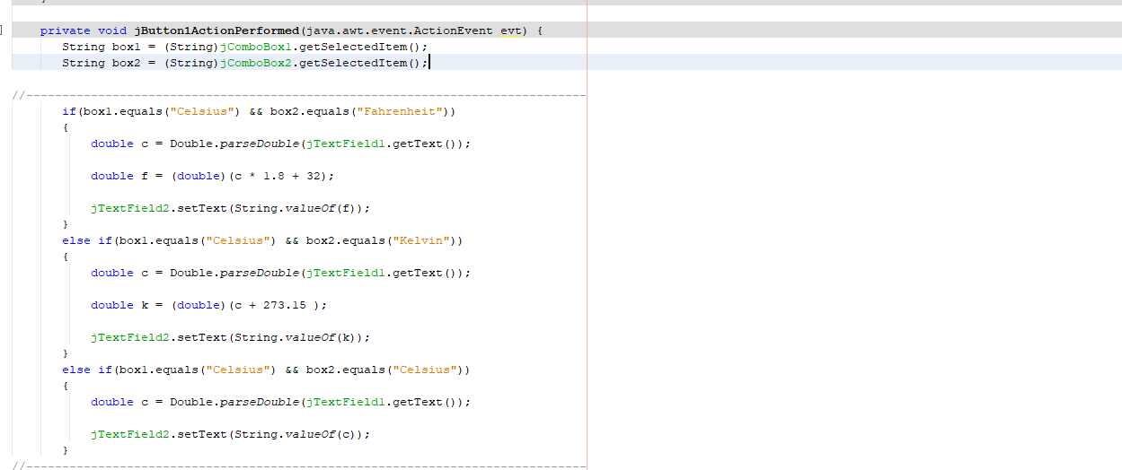
Convert Button:

Slide 10
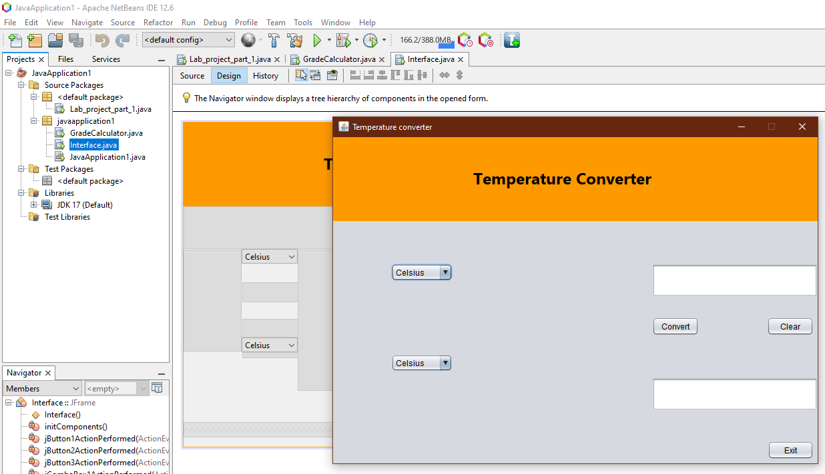
Project Output:

Slide 11
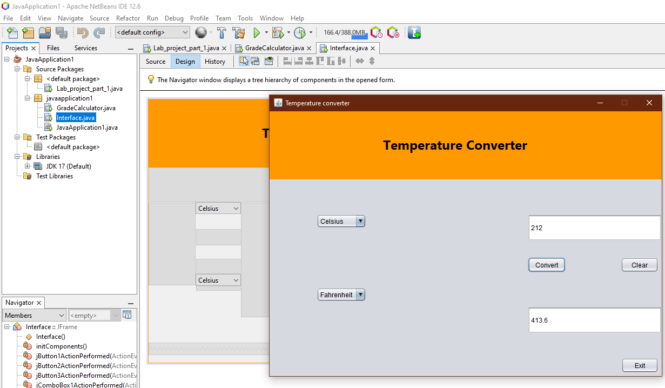

Slide 12
Project Name: A grade calculator to calculate a students total marks, percentage & grade.
Introduction:
A grade calculator can calculate the total marks of a student by adding all the subjects marks. Then it can calculate the total percentage of marks by dividing the sum with the number of subjects. Finally for calculating the grade of the students we set a conditions for calculating the grade with the help of percentage of marks of a student.
Applications:
While publishing a students grades a grade calculator is necessary. It can help to calculate a students total number, percentage of number and grade of a student.It will help in academic result publication.
Motivation:
A grade calculator can be of use to a student. Since it can calculate a students total marks, percentage and grade of the total exam we selected this project.

Slide 13
Flow chart:
Creating the UI for the calculator using Java swing
Programming the clear and exit button
Creating the UI for the calculator using Java swing
Creating the UI for the calculator using Java swing

Slide 14
Function Description: We used Java swing to creat the grade calculator. we used Jframe form to do so. For the UI components we used swing containers and swing control. For IDE we used NetBeans. The functions we used are listed below:
Javax.swing.jFrame:
jframe is class type of container. It works like the main window where the swing containers and controls are added.
Javax.swing.JPanel:
Jpanel is a generic lightweight container. Jpanel is used here to enrich the UI. The label is hence used on JPanel.
Javax.swing.JLabel:
Label is used to name the calculator here. Here it is a grade calculator. So it is named using label.
Javax.swing.JTextField:
Here in our project we have nine textfields. First textfield is for users name. Then next five textfield is for taking input for subjetcs. Then the next three textfields are total number, number percentage and grade.

Slide 15
Javax.swing.JButton: In our project we have five buttons. The exit button is for the program to exit. The clear button is for the textfields to set empty string. We have a button to calculate the total number of a student. A Button to calculate the percentage. Then a button to calculate the grade of a student.

Slide 16
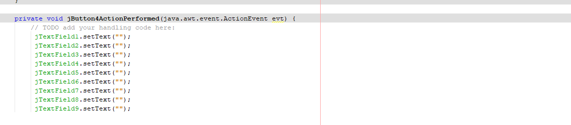
Button Action Perform: Exit Button:
Clear Button:

Slide 17
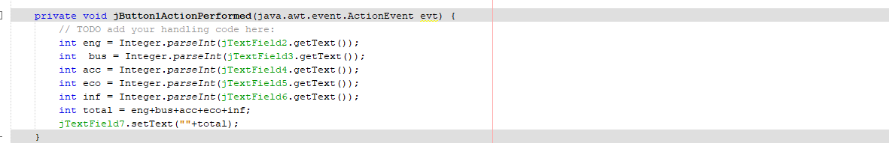
Total Button:
Percentage Button:

Slide 18
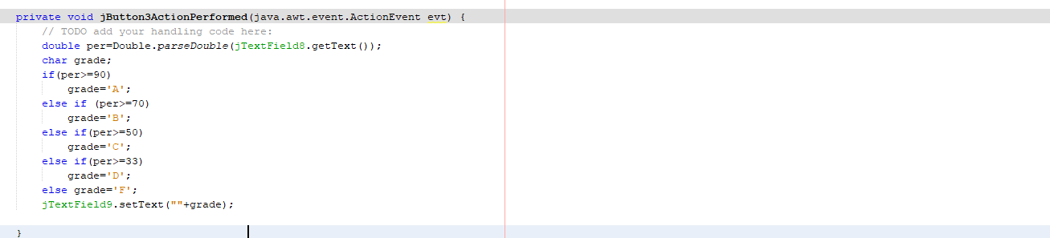
Grade Button:

Slide 19
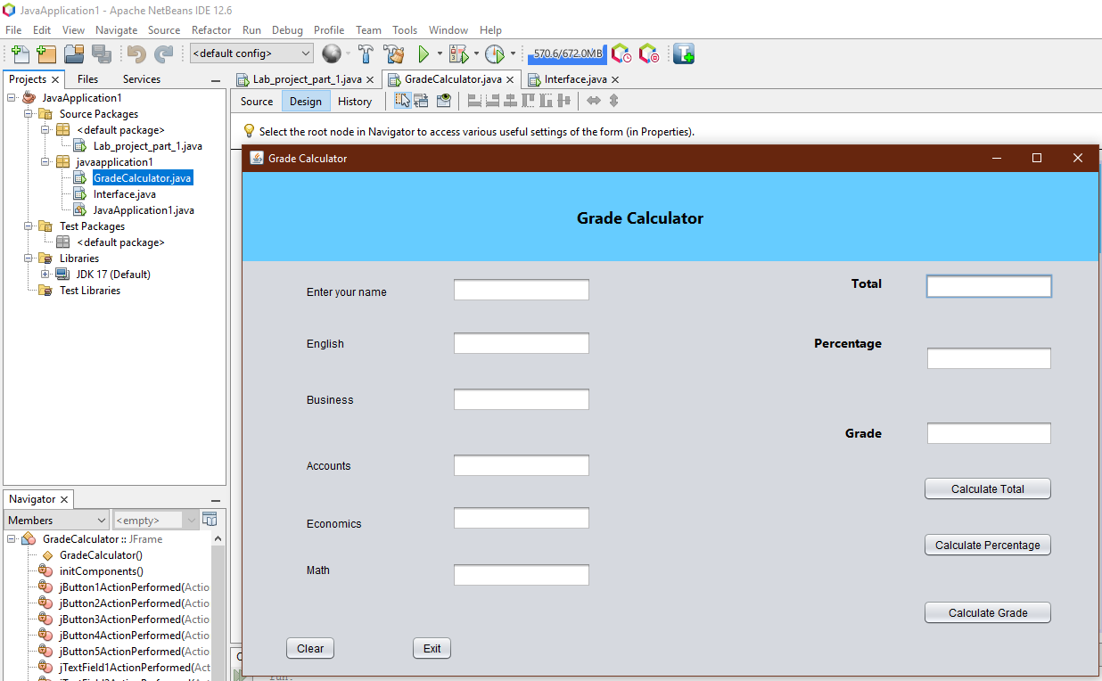
Project Output:

Slide 20
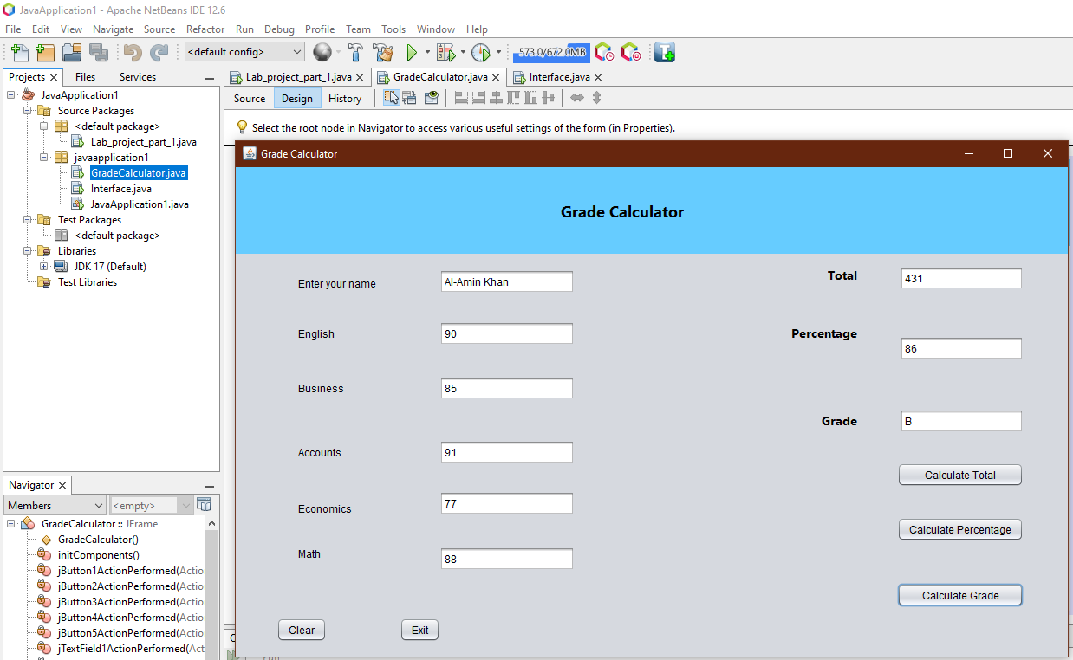

Slide 21
Conclusion: In this project we created a temperature coverter and a grade calculator using Java Swing. We used swing containers and controls to creat the UI for both the projects. We programmed the JButton events as action for both the converter and grade calculator. In our converter we can convert in three differerent scales. For the grade calculator we can measue a students total number, number percentage and grade for five subjetcs. Thus we completed our both project successfully without any error.

Slide 22
Thank you for listening

